Slide 1
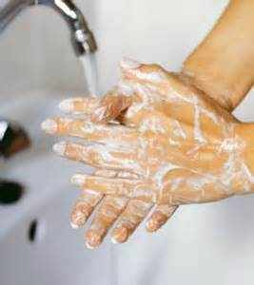
Water Sector Trust Fund
Hygiene Practices
Version:2.0 Last Update: August 2017

Slide 2
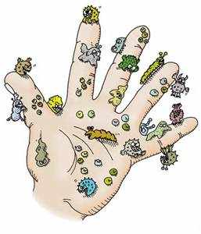
Don’t get sick!
You should always wear your protective equipment when emptying the UDDT (dry toilet)!
The protective equipment is there to protect you from the pathogens that are found in human excreta.
Quality protective equipment that is durable, comfortable and meets the public health needs should be purchased and used

Slide 3
Faecal - Oral diseases
Occur when pathogens (germs) in faeces pass from one host into the oral cavity of another host
Diseases | Examples
Bacterial diseases | Cholera, Diarrhea Typhoid and Paratyphoid Bacillary Dysentery
Protozoan diseases | Amoebic Dysentery
Viral diseases | Hepatitis B Poliomyelitis Gastro enteritis (affecting the cavity, stomach and intestines)
Parasitism | Tapeworms Roundworms Pinworms

Slide 4
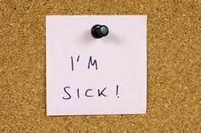
Further conditions
Skin rashes
Hoarse voice
Teary eyes
Stomach ache
Nausea
Vomiting

Slide 5
Hygiene practices
Personal Hygiene practices
Hand washing | Thoroughly wash your hands with soap and water during the training
Nail care | Trim the nails. Use a brush to scrub your nails
Body care | Cleanliness of the entire body
2.Domestic Hygiene
Protection of family | Cleanliness of their own homes to protect also their families (sweeping, washing, cleaning clothes, toilets, beddings)
Hygiene for animals | Pets at home, sheep, dogs etc.
3.Household hygiene
Cleanliness in the home | For a clean and healthy house, all equipment should be cleaned on a regularly

Slide 6
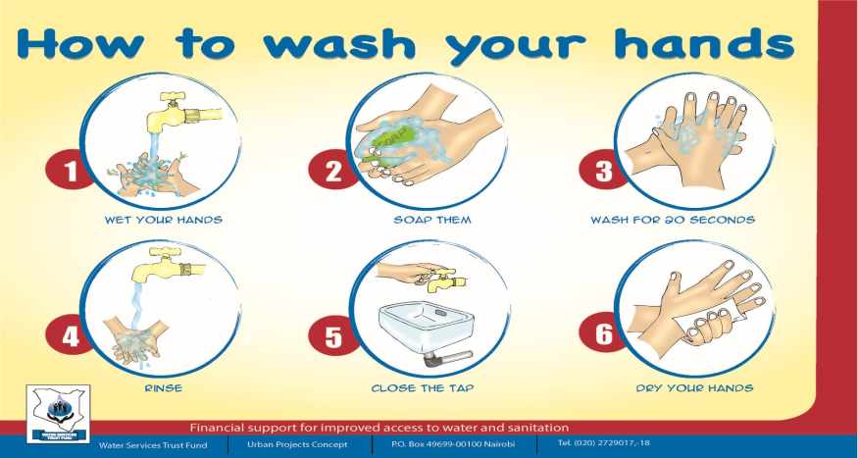
How to wash your hands
Notes:
Simulate handwashing

Slide 7
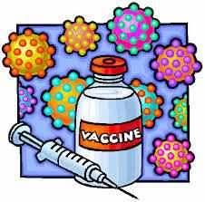
Vaccinations
Here is a list of the most important vaccinations that you require
Hepatitis B (3 doses)
Tetanus
Typhoid
Please ensure that you take de-worming tablets to protect you from worms!

